Slide 1

Fast Food Consumption Survey
Unhealthy – Often high in fats, sugar, and calories.
Leads to obesity – Regular consumption can cause weight gain.
Low nutritional value – Lacks vitamins, minerals, and fiber.
Can cause diseases – Linked to heart problems, diabetes, and digestion issues.
Addictive – Makes people crave it more due to added flavors and salt.

Slide 2



UNDERSTANDING
FAST Food's Role and Health
Consequences
Fast food consists of quickly prepared meals, often high in calories, fats, sugars, and salt, typically offered in restaurants with limited table service or as takeout.
Its widespread availability and convenience have established it as a staple in modern diets worldwide.
Studying fast food's health effects is vital due to its association with rising rates of chronic diseases and widespread nutritional imbalances.
Awareness of fast food's role in diet is crucial for addressing public health challenges linked to obesity, diabetes, and cardiovascular conditions.
The growing influence of fasi fooc! on global diets and chronic disease trends

Slide 3
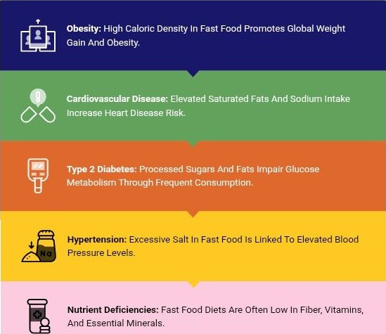
Critical Health Risks of Regular fast Food Intake
Understanding how fast food components directly impact chronic disease development

Slide 4
Survey Scope, Goals, and Methodology Overview
Comprehensive insights on fast food consumption and health correlations
Purpose to assess fast food consumption patterns and their correlation with health metrics
Sample of 5,000 US participants aged 15- 65 from urban and rural areas
Balanced demographics across gender, age, and income to ensure representativeness
Questionnaire covers frequency and types of fast food consumed plus health status and Iifesty!e
Data collected via online questionnaires and health screenings at community centers

Slide 5
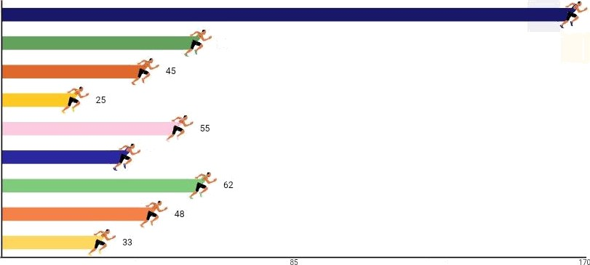
Fast Fod Consumption by Age, Gender & Income
US 2023 survey data reveals demographic and socioeconomic consumption patterns
Age 15-J7
170
Age 18-34
60
Age 51+
Male
Weekly Fast Food Consumption (%)
Female
40
Low Income
Middle Income
High Income
42.5
Demographic Groups

Slide 6
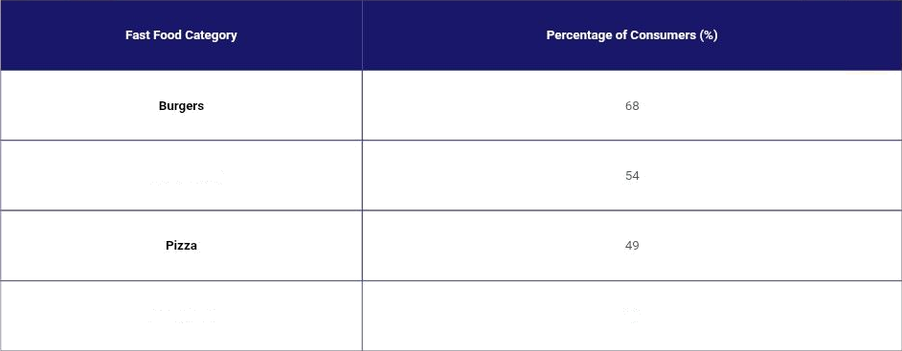
Top fast Food Choices Revealed by Survey
Burgers lead consumption, n'ith fried chicken and pizza following closely
Fried Chicken
Sandwiches
37

Slide 7


Fast Food Frequency Strongly Linked to Health Risks
Survey reveal rising BM I, blood pressure, an‹I prediabetes rates increased fast food intake
Data reveal a strong positive correlation between fast food meal frequency and worsening health metrics.
Prediabetes incidence doubles: 12% in frequent consumers (>4 meals/week) vs 5°t in rare consumers, linked to elevated fasting glucose.
Systolic blood pressure rises from 118 mmHg (s1 meal/week) to 132 mmHg (>5 meals/week),
BMI increases from 24 (0-
1 meals/week) to 29 (>5 meals/week), indicating weight gain trends.

Slide 8


Common Misconceptions About Fast Food and Health
Fast food is always unhealthy: Some choices can be balanced, lower in fat or sugar, and offer reasonable nutrition.
Occasional fast food is harmless: Even infrequent intake may impact health negatively when combined with an overall poor died.
Clarifying frequent myths to understand real health
implications
Only overweight individuals face health risks: Health issues like high blood pressure and elevated cholesterol affect all body types.

Slide 9





Case Studies Linking Fast Food to
Health Risks
A longitudinal study found a 25% higher incidence of type 2 diabetes among adults consuming fast food more than four times weekly over five years
A survey reported a 30% increase in obesity rates among adolescents with daily fast food intake
These case studies demonstrate a clear direct relationship between frequent fast food consumption and chronic health conditions
Data reveals higher diabetes and obesity rafrom frequent fast food consum|›1ion

Slide 10
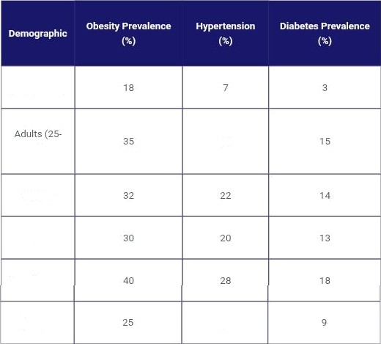
Health Impacts of FAST Food Across Demographics
Youth (15-24)
64)
25
Males
Females
Low income
High Income
15

Slide 11


Nutritional Deficits in Fast Food Diets Driving Chronic Risks
Dietary Fiber Deficiency Lack of fiber impairs digestion and cholesterol regulation, increasing risks of constipation and heart disease.
Vitamin A, C, D Deficits
Insufficient vitamins reduce immune defenses and metabolic efficiency.
Calcium and Magnesium Shortages
Mineral deficits undermine bone strength and metabolic
functions.
Increased Chronic Disease Vulnerability
Combined deficits in fiber, vitamins, and minerals elevate susceplibility to chronic iilnesses among frequent consumers.

Slide 12





Elective Strategies to Mitigate Health
Risks from Fast Food
Choose healthier menu options such as salads, grilled items, and smaller portions to reduce calorie intake
Limit fast food consumption to less than twice weekly to minimize adverse health effects
Increase physical activity to offset excess calories from fast food meals
Actionable steps for individuals and policymakers
to reduce negative health in pact s
Support policies that ensure nutñ€ional transparency and mandate reduction of sodium and fat content
Encourage oommunity programs that educate on balanced diets and healthier lifestyle choices

Slide 13



Targeted Strategies to Mitigate Fast Food Health Risks
Coordinated efforts by governments, communities, and individuals reduce diseases burden.
Governments should enforce labeling regulations and restrict trans fats and sodium in fast food products
Communities need to expand nutrition education programs and improve access to healthy food alternatives
Individuals must focus on balaneed meals, plan ahead to limit fast food consumption, and maintain regular physical acdvity
Collective action across all levels can effectively reduce health risks linked to fast food consumption

Slide 14
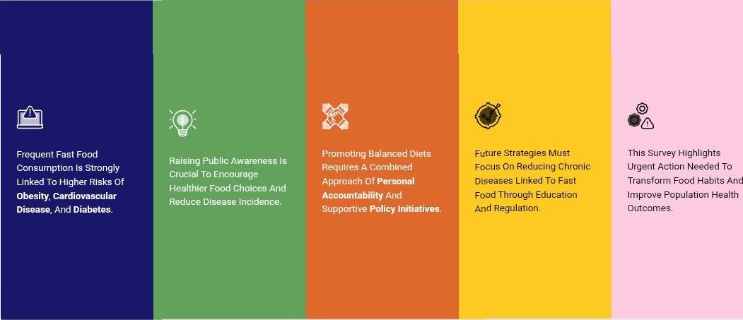
SUMMARY and Future Directions toward Healtheir Food Habits

